Slide 1

101

Slide 2
What is Git?
Free and Open Source
Distributed Version Control System (DVCS)
Created by Linus Torvalds in 2005 to aid in Linux Kernel Development
A tool for collaborative development

Slide 3
DV.. What!!??
“In software development, distributed version control is a form of version control in which the complete codebase, including its full history, is mirrored on every developer's computer.” -- Wikipedia

Slide 4
So how does it work?
Easy.. it stalks your code!
Records what your files look like at any given point of time.
Whenever you ask, it takes a snapshot of your files.
Let’s you go back to visit any snapshot.

Slide 5
What are Commits?
Act of taking a snapshot
Any repository is essentially a group of commits

Slide 6
And what about Repositories
A collection of all the files and the history of all those files
Lovingly also called a ‘Repo’
Can live on a local system or on a remote server. (GitHub, GitLab, etc.)
Allows cloning!

Slide 7
Wait.. Cloning o_o ??
The act of copying a repository from a remote server is called Cloning.
Teams collaborate by cloning a repository from a remote server.
Essentially such a system allows you to pull / push changes.

Slide 8
Now what’s pulling and pushing?
Pulling is the process of downloading commits that don’t exist on your machine from a remote server.
Pushing is the process of uploading your changes (commits) to the remote repository.

Slide 9
What about a HEAD?
Simple: It’s a reference to the most recent commit in the repository.

Slide 10
What about Branches and Merges?
An independent line of development under a repository.
Usually, the main branch in a project is called a master.
A repository can contain multiple branches.
Combining the changes from two branches into one is called a merge.

Slide 11
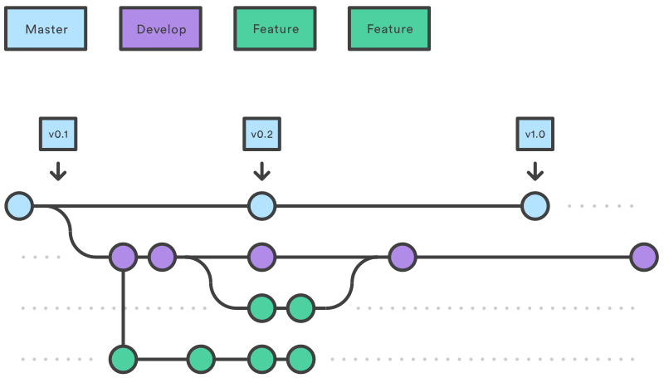
So what does a branch look like?

Slide 12
So how do I get started in 6 steps
Install git
Initialize a new repo: git init
Add files to it: git add
Commit those files (or their changes): git commit
Push changes to your remote repository: git push
Create a new merge request / pull request.

Slide 13

Time to move to GitHub!!

Slide 14
Helpful Links
MLH Hack Day Resources:
https://www.notion.so/Welcome-to-Local-Hack-Day-BUILD-e4fb1d6c938b48c29d84e2f849018bc7
Facebook Developer Circle Pune GitHub Org: https://github.com/devcpune

Slide 15

That’s all folks!!
https://sayak.in

